Slide 1
Near-Term Climate Mitigation
Side Event, Cop-16
7 December 2010
Room Pitaya, Cancun Messe, Mexico
V Ramanathan

Slide 2
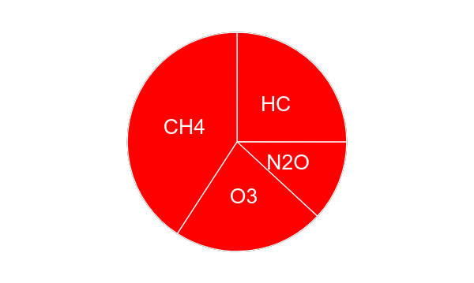
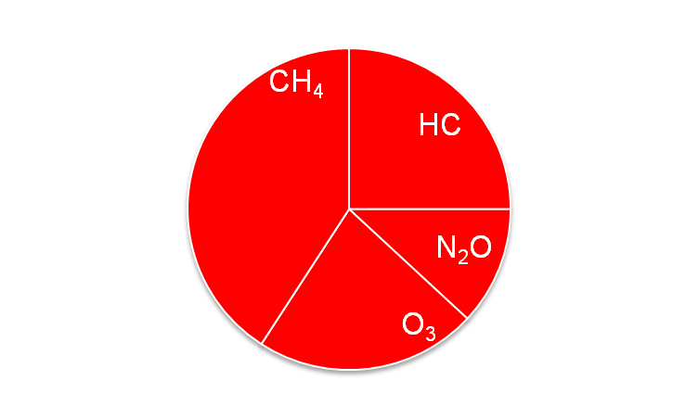
Heat Trapped by Carbon Dioxide and Other Climate Pollutants
as of 2005
Carbon Dioxide
The other pollutants
have almost the same
warming effect as
Carbon Dioxide
soot
Source: IPCC-2007;
Ramanathan and Xu, 2010

Slide 3
How Long Have We known About the other Climate Pollutants?
1975
One molecule of CFC has the same greenhouse
effect as the addition of more than 10,000 molecules
of Carbon Dioxide to the Atmosphere

Slide 4
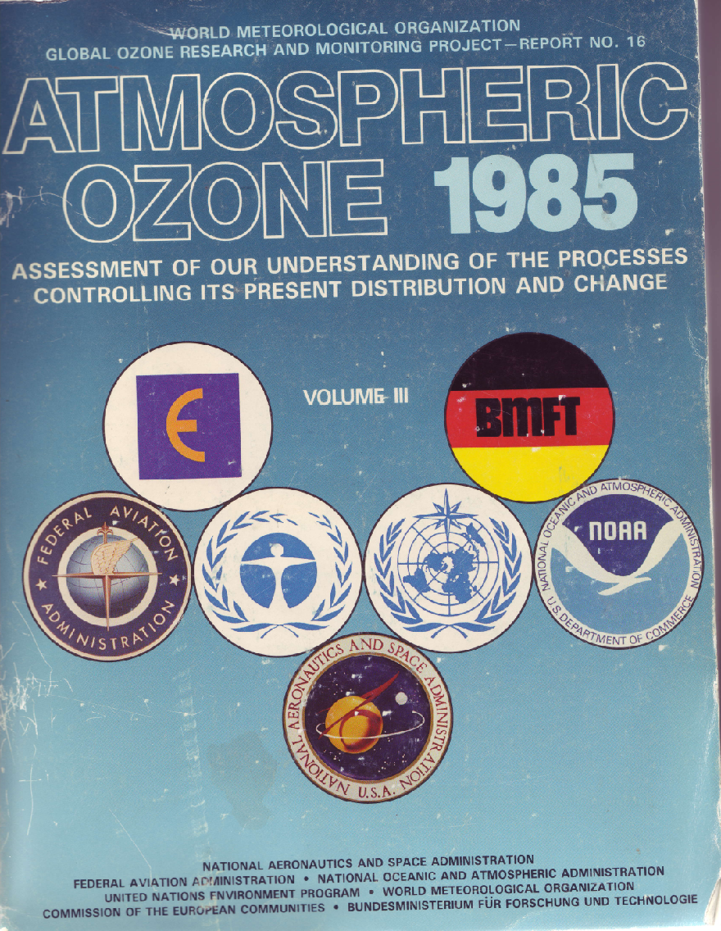
When was the First International Assessment of the Other Pollutants?
Non-CO₂ Gases contribute as
much as CO₂ to climate Change

Slide 5
What do we mean by Near-Term ?
With just carbon-dioxide mitigation, the warming is likely
to exceed 1.5 C to 2 C during the next 30 to 60 years
Ref: Ramanathan and Xu, 2010
Raes and Seinfeld, 2009
Mcracken, …..

Slide 6
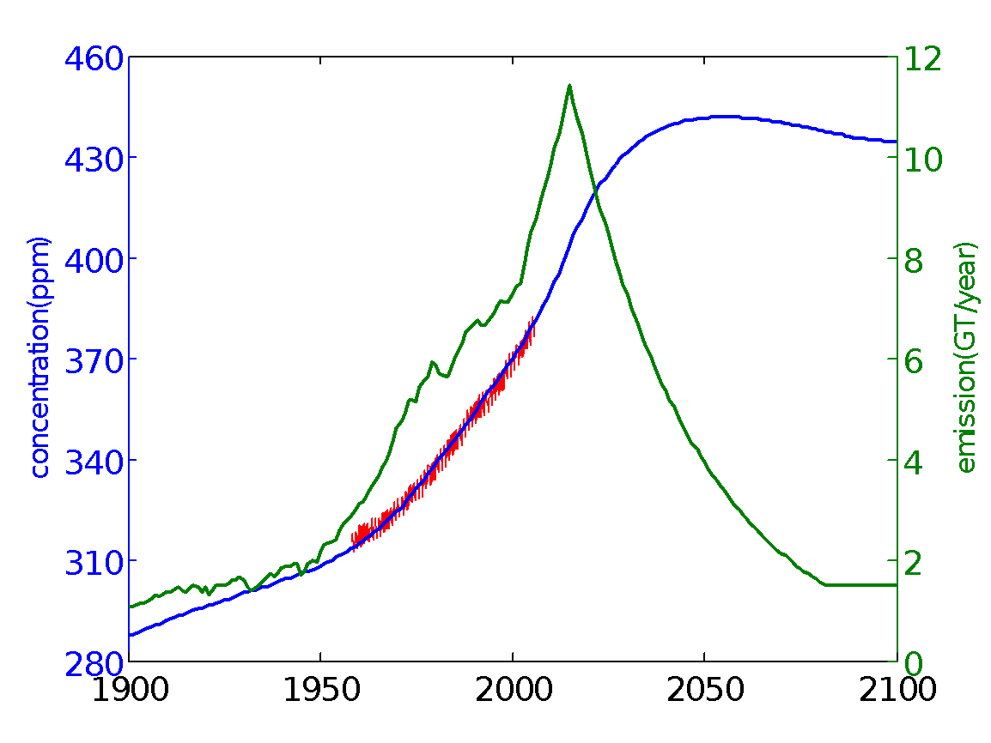
Even with 50% reductions by 2050, CO₂ will Increase to 440 PPM; Commit More warming
CO₂ reductions have to be complemented with Reductions in short-lived non-CO₂ warming agents

Slide 7
Mitigation Long-Term Near –Term
Build-up of Carbon Dioxide
Results from burning fossil fuels – essential to modern life
Remains in air for centuries
Main contributor to warming
Cutting down this emission is the permanent solution
Short-lived Gases &
Dark Soot Particles
3 Gases - Methane, HFC [Hydro Fluorocarbons] and lower atmospheric ozone
Pollutants last several days to few decades in air
Current Warming effect - 80% of that of Carbon Dioxide
Cutting down will buy time till permanent solution is in place

Slide 8
By Mitigating emissions of short-term climate pollutants
Can Delay large warming by few decades:
Ramanathan and Xu, 2010

Slide 9
Primary Mitigation Advantages of Near-Term Climate Pollutants
Easier to reduce. People can see immediate benefit
Technology and regulatory systems are available
Can be done locally and Nationally
Need proper incentives
Why the delays?
Poor Incentives - cumbersome accounting systems in climate diplomacy

Slide 10
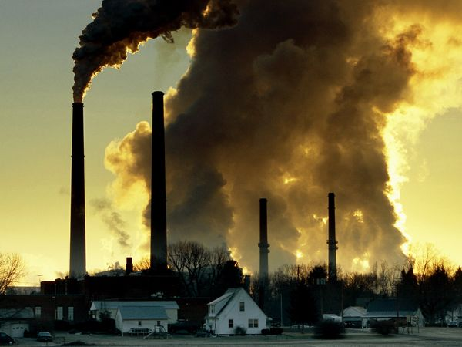
Some Visible Effects of Pollutants Ozone; Methane; Soot
Regional: Melting of arctic snow and ice; Large warming of the
Himalayan-Tibetan Region ; Disrupting Monsoonal circulation
Air pollution – unhealthy air
Over 1.5 million deaths
annually
Threat to Agriculture; Billions of dollars lost due to crop damages
B

Slide 11
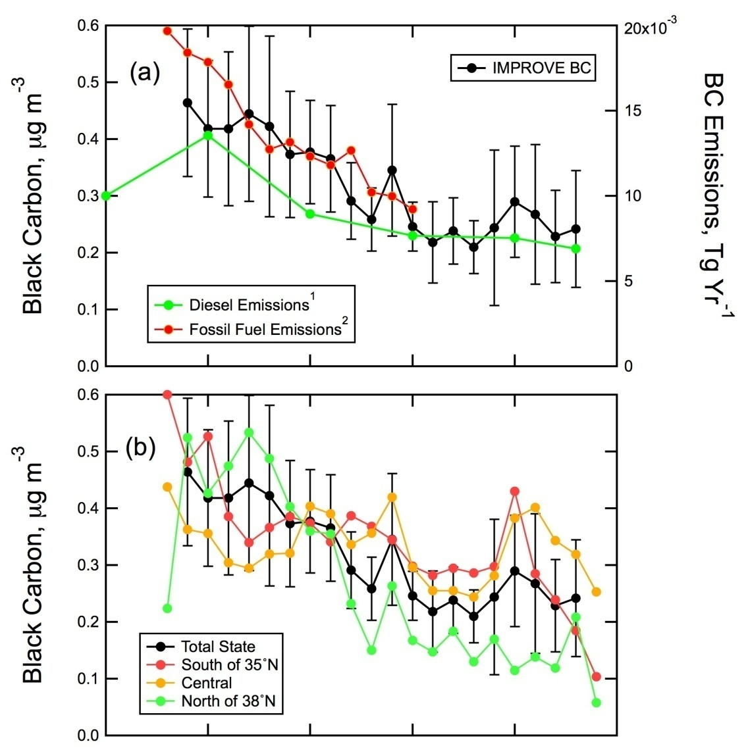
California Has Reduced its Black carbon Reductions
By 50% from 1989 to 2008
Bahadur , Feng, Russell, Ramanathan, 2010
1985
2010

Slide 12
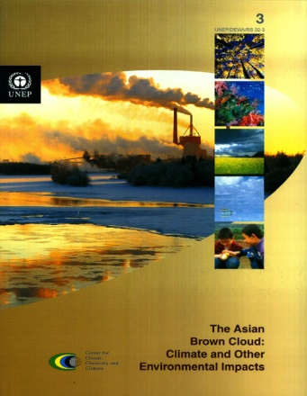
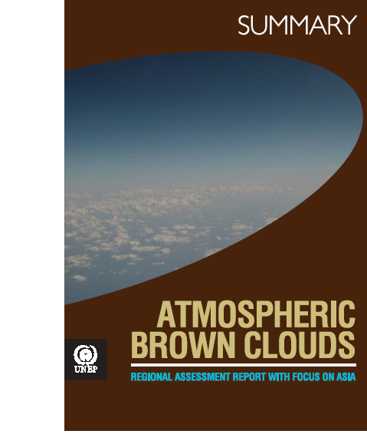
UNEP’s ABC PROJECT
Preliminary Assessment Report, Aug 2002
The first impact assessment report, Nov 2008
Think Globally
Assess Regionally

Slide 13
UNEP integrated assessment of tropospheric ozone and black carbon (Preview)
Assessment Chair: Drew Shindell (NASA Goddard Institute for Space Studies, USA)
Assessment Vice Chairs: Frank Raes (EU Joint Research Centre, Ispra, Italy)
V. Ramanathan (Scripps, Univ. of California, USA)
Kim Oanh (Asian Institute of Technology (AIT), Thailand)
Luis Cifuentes (Pontificia Universidad Católica ,Chile)
Assessment Scientific
Secretariat: Johan Kuylenstierna, Kevin Hicks, SEI / Global Atmospheric Pollution Forum
UNEP Coordinator: Volodymyr Demkine, UNEP DEWA
Coordinating Lead Authors: Emissions: David Streets; Atmospheric processes: David Fowler; Impacts: Lisa Emberson; Measures: Martin Williams
Modelling: Emissions - Markus Amann, IIASA (GAINS)
GCMs: Drew Shindell et al – NASA GISS,
Elisabetta Vignati et al - ECHAM and FASST Tool at JRC
Health: Susan Anenberg, US EPA
Crops: Rita van Dingenen – JRC Ispra
Economic Valuation – Nicholas Muller, Middlebury College

Slide 14
Group 1: ‘Methane Only’: Technical measures for methane emissions
UNEP: Shindell et al, 2011
Extended recovery of coal mine gas
Extended recovery and flaring (instead of venting) of associated gas from production of crude oil and natural gas
Reduced gas leakage at compressor stations in long-distance gas transmission pipelines
Separation and treatment of biodegradable municipal waste through recycling, composting and anaerobic digestion
Upgrading primary wastewater treatment to secondary/tertiary treatment with gas recovery and overflow control
Control of methane emissions from livestock, mainly through farm-scale anaerobic digestion of manure from cattle and pigs with liquid manure management
Intermittent aeration of continuously flooded rice paddies

Slide 15
Group 2: ‘BC Tech’: Technical measures for black carbon
UNEP: Shindell et al, 2011
Replacing traditional coke ovens with modern recovery ovens, including the improvement of end-of-pipe abatement measures (in developing countries)
Replacing traditional brick kilns with vertical shaft kilns and Hoffman kilns where considered feasible (in developing countries)
Diesel particle filters for road vehicles and off-road mobile sources (excluding shipping)
Particle control at stationary engines
Improved stoves in developing countries in residential sector
Additional measures considered
[6. Wide-scale introduction of pellets stoves and boilers in the residential sector (in industrialized countries)
[7. Use of coal briquettes in residential sector]
What about coal briquettes in China and BC emission control in E and N america – 16 measures – or part of 3??? Also improved stoves????

Slide 16
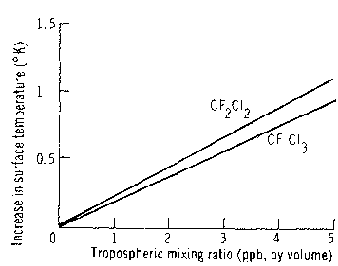
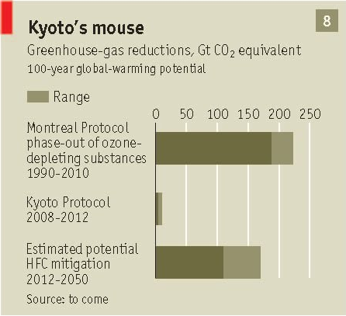
We have mitigated Climate Change Already We can do it again
Ramanathan, 1975
Zaelke, 2009

