Slide 1

Strategies for containing climate change below
unmanageable levels: Beyond Copenhagen
V Ramanathan
July 20, 2010
Jet Propulsion Laboratory
Pasadena, CA

Slide 2
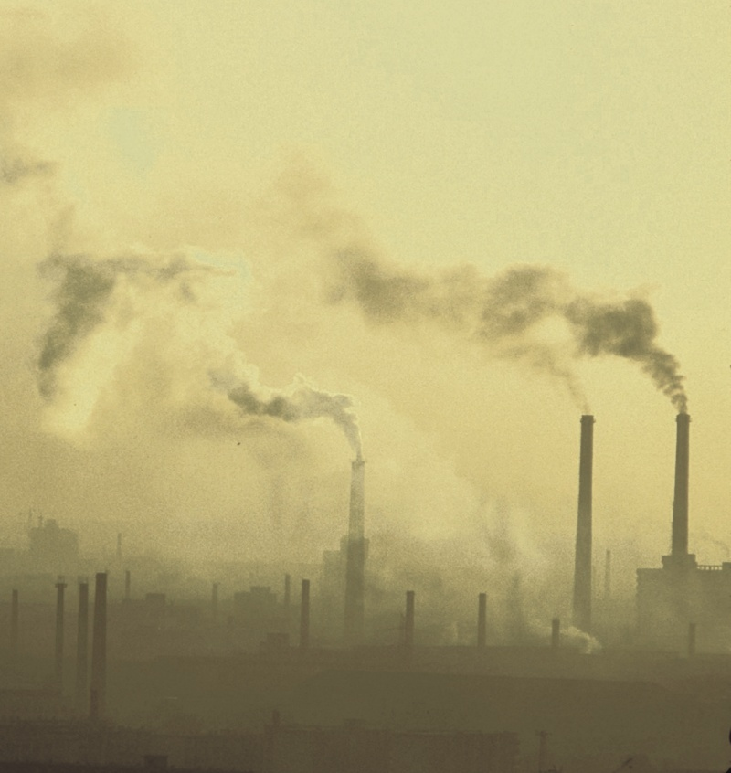
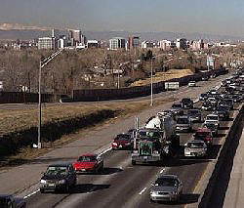
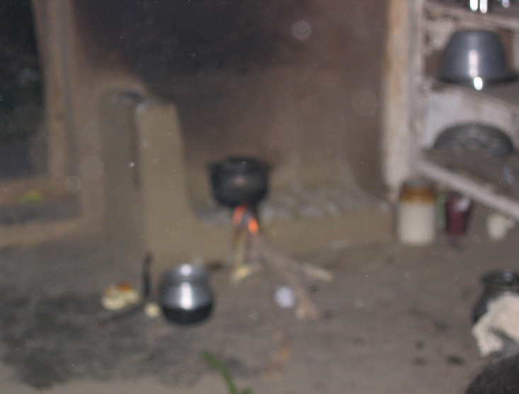
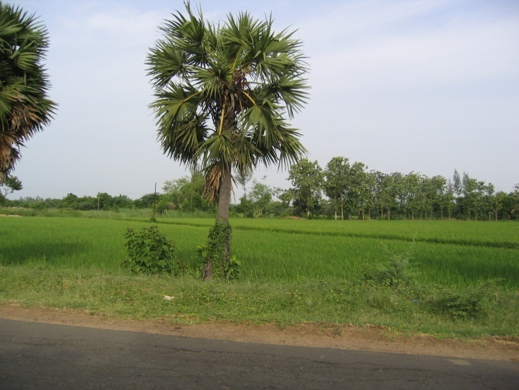
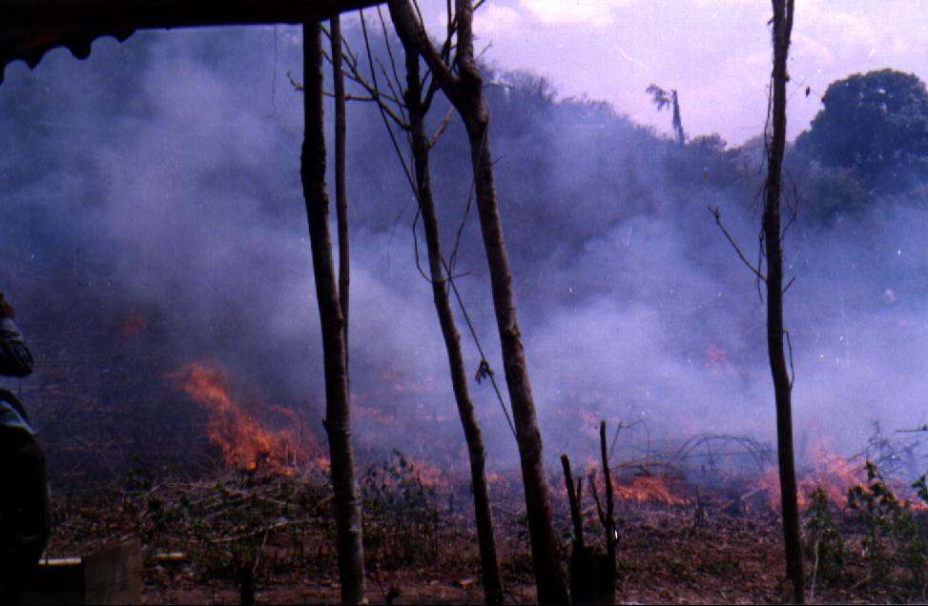
Sources of greenhouse Gases and Aerosols in Brown Clouds.
Ramanathan 2007

Slide 3

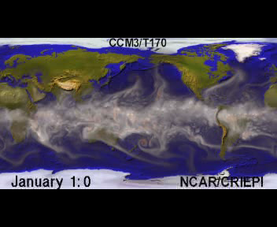
Global Atmosphere
Global Atmosphere
Source: Washington, NCAR, 2005
Ramanathan 2007

Slide 4
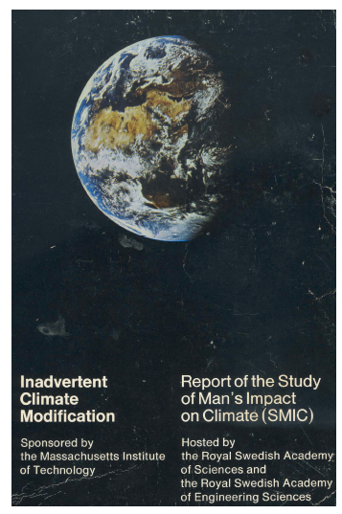
PUBLISHED 1971
Oh, Mother earth, ocean-girdled and mountain-
breasted, pardon me for trampling on you
Sanskrit Prayer

Slide 5

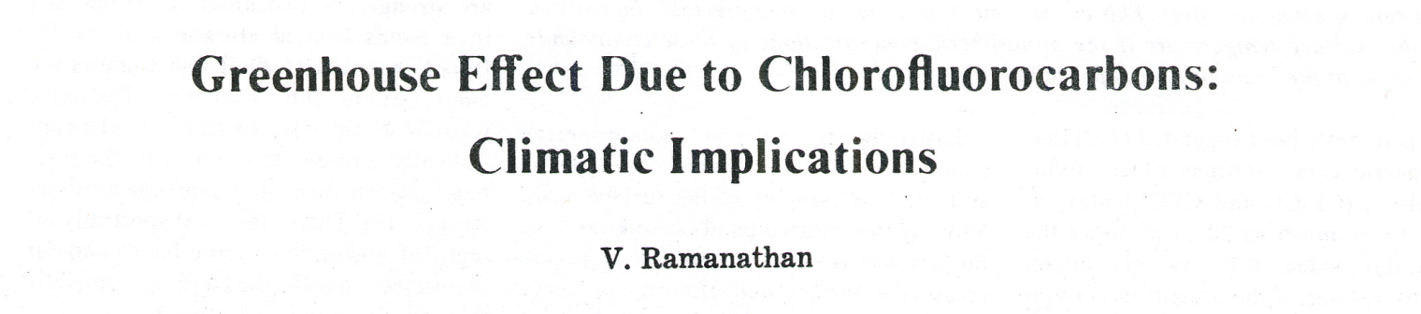
1975
Abstract. The infrared bands of chlorofluorocarbons and chlorocarbons enhance the atmospheric greenhouse effect. This enhancement may lead to an appreciable increase in the global surface temperature if the atmospheric concentrations of these compounds reach values of the order of 2 parts per billion.
One molecule of CFC has the same greenhouse
effect as the addition of more than 10000 molecules
of Carbon Dioxide to the Atmosphere

Slide 6
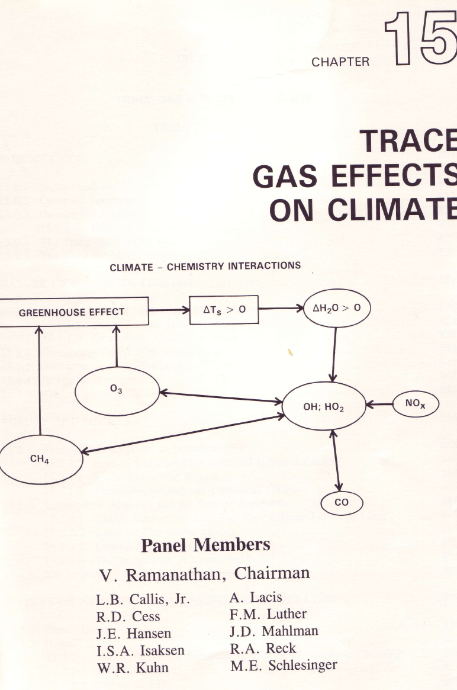
Non-CO2 Gases contribute as much as CO2
to climate Change

Slide 7
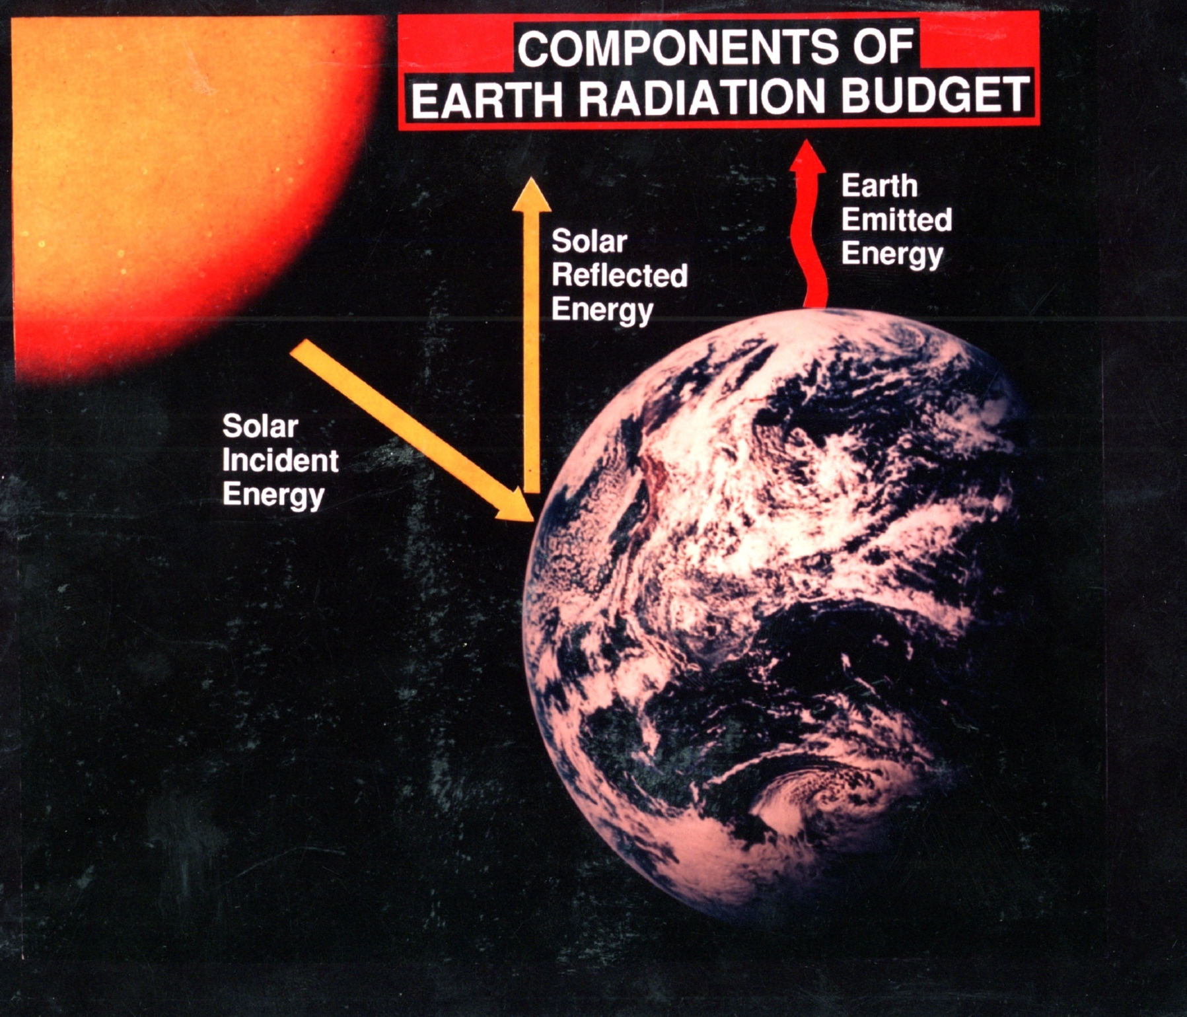
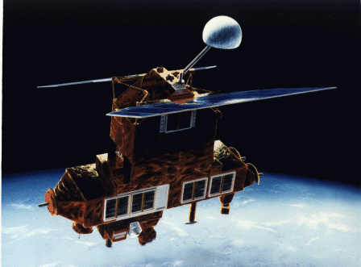
1
Units; Wm⁻²
3
G
399
σΤ⁴
G=131
268
F_{TOA}
Raval & Ramanathan, Nature 1989
Ramanathan & Inamdar, CUPS, 2006

Slide 8
The Water Vapor Feedback
Temp dependence of
Saturation vapor
pressure:
σT⁴
e_{s}: e^{-5400/T}
σΤ⁴

Slide 9
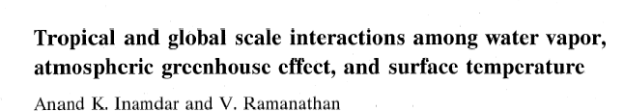
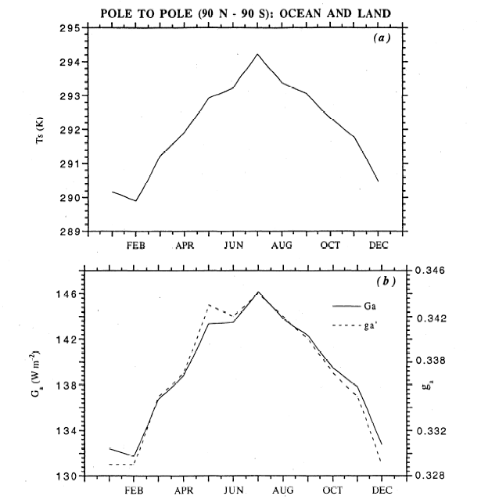
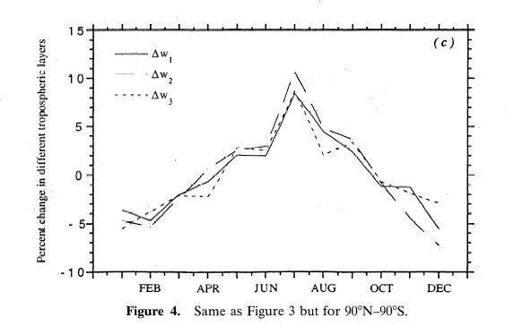

Slide 10

Unit: Wm⁻²K⁻¹
σT⁴
1.9
G
3 Wm⁻²
σΤ⁴
The planet gives off 1.9 Wm⁻² per degree C increase in Temperature
Inamdar and Ramanathan 1998

Slide 11
Ramanathan and Feng, 2008
IPCC-AR4 (2007) Concludes:
For a CO₂ doubling, the most likely climate sensitivity is 3 C warming
with a 90% confidence interval of 2 to 4.5⁰C
For doubling of CO₂, TOA forcing is : 3.7 Wm⁻²
So it takes about 1.25 Wm⁻² (3.7/3) to warm the planet by 1⁰C
The GHGs so far have added 3 Wm⁻² forcing
The committed (or the inevitable) warming is 2.4⁰C

Slide 12
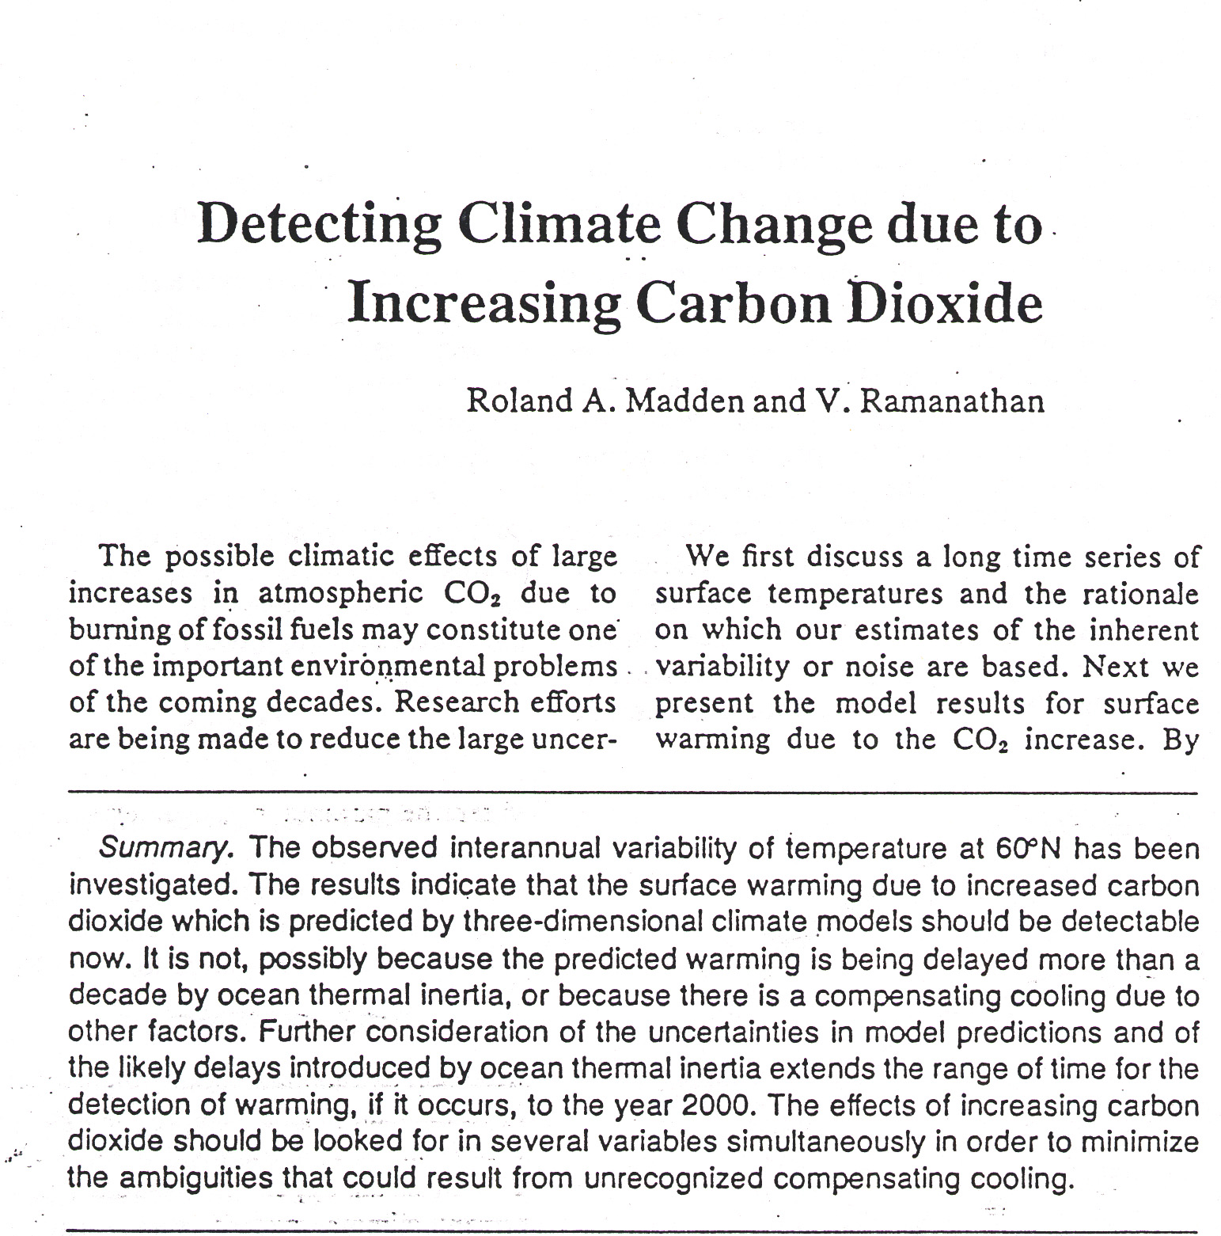
1980

Slide 13
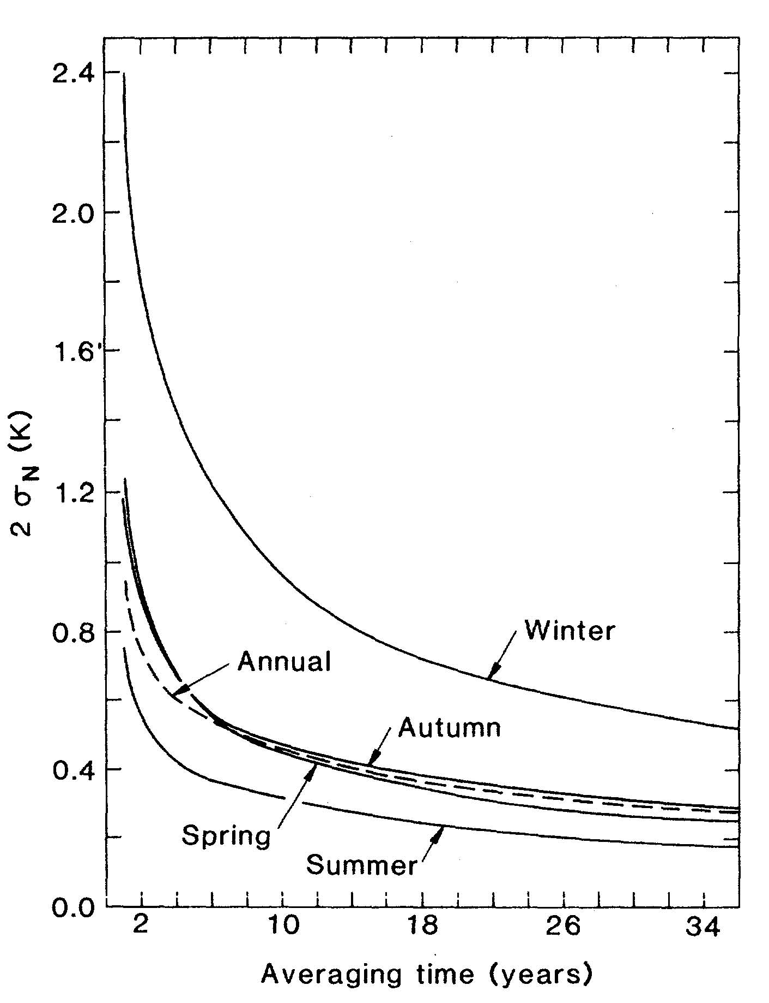
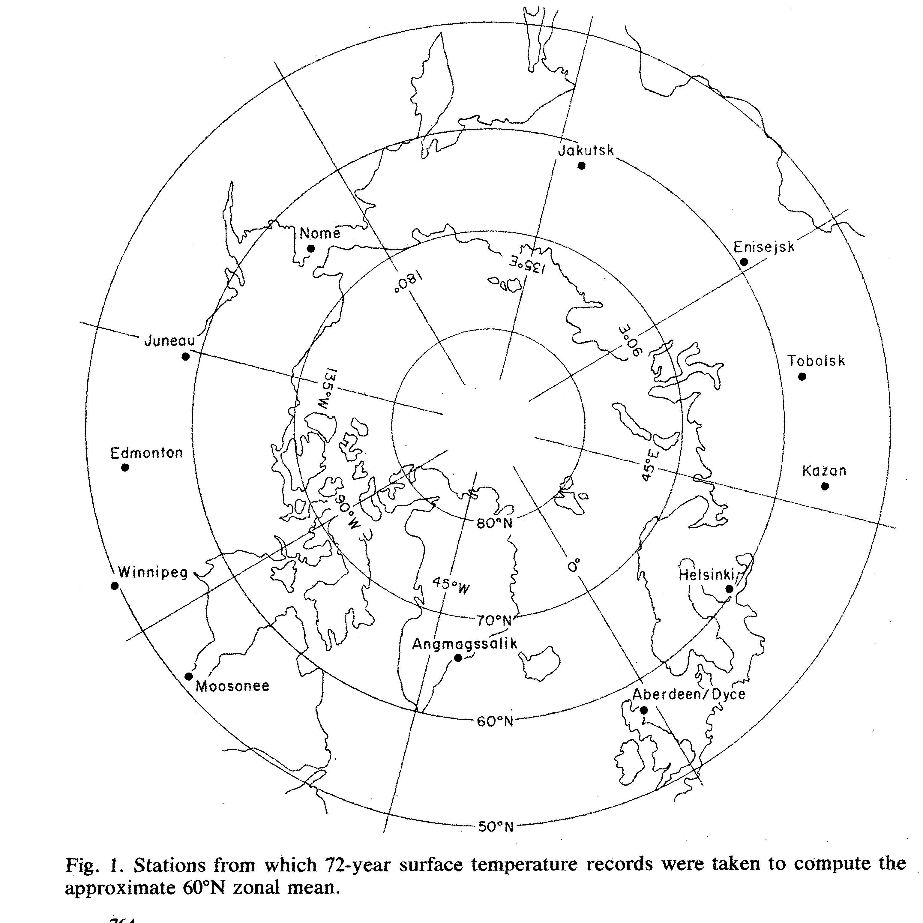
Homogeneous Temp Record:1906-1977
Noise Spectrum

Slide 14
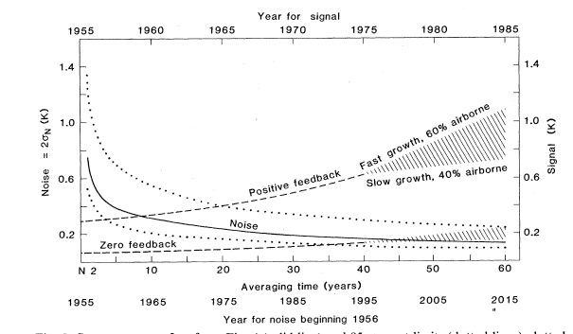
Analysis of Stochastic Climate Noise and Climate “signal”
Madden & Ramanathan, Science 1980
4%
4⁰C for 2 X
2%
1⁰C for 2X

Slide 15
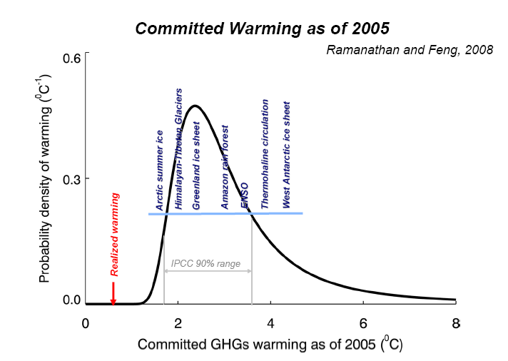
‘Fat Tail’
Committed warming derived from IPCC Forcing & IPCC climate sensitivity

Slide 16
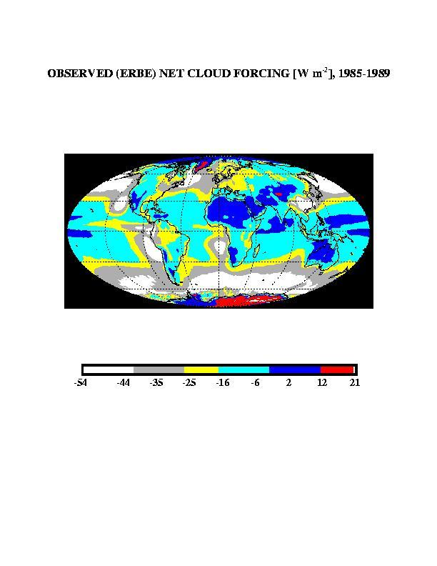
The Gordion Knot: Will a warmer planet Increase or
Decrease Cloud radiative Forcing?
Ramanathan et al, Science 1989

Slide 17
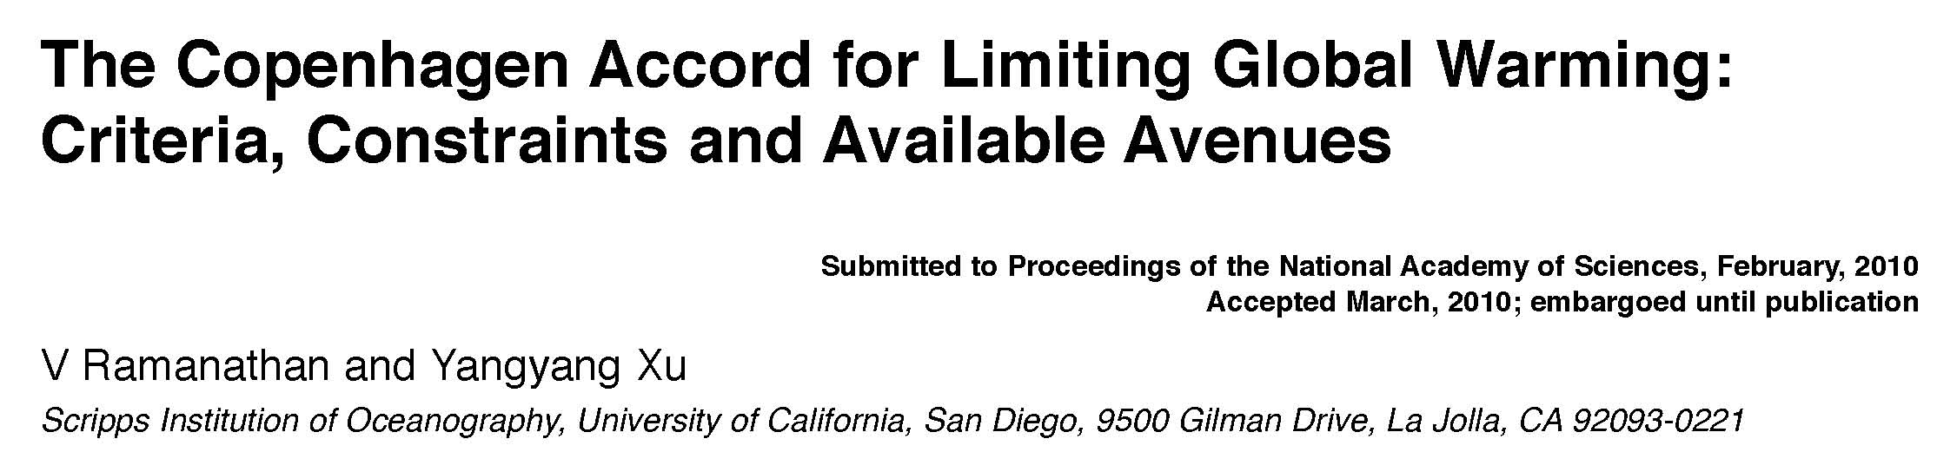
Forcing at 2005
Proceedings of the National Academy of Sciences, 2010
CO₂
MASK
Net forcing
BC
Heat Trapped by CO₂, Non-CO₂ gases, Black Carbon and
Masking by Sulfates-Nitrates-Organic Aerosols

Slide 18
The Unmasking has begun in full force:
Ref: Smith, 2010
Data: Smith, PNNL

Slide 19
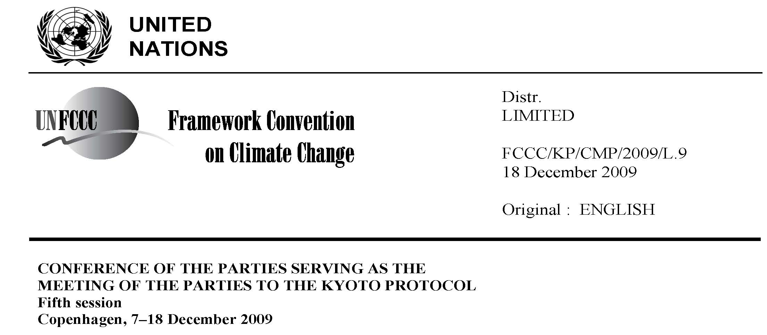
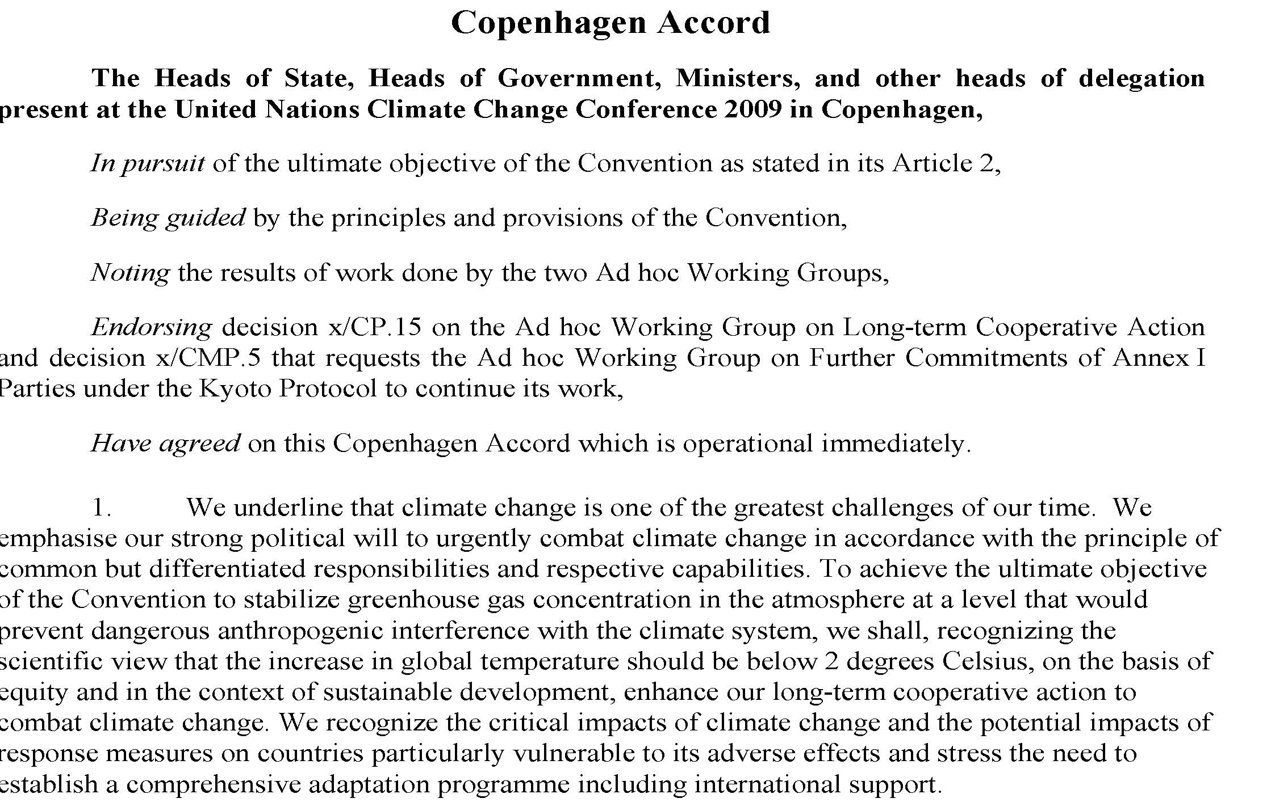

Slide 20
Even with 50% reductions by 2050, CO2 will Increase to 440 PPM; Commit another 1 C warming
CO2 reductions have to be complemented with Reductions in short-lived non-CO2 warming agents

Slide 21
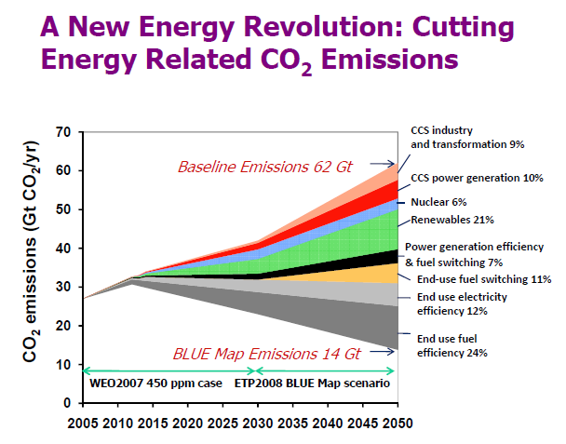
Intl Energy Angecy- 2008 Report
.. Total additional investment needs in technology and deployment between now and 2050 would amount to USD 45 trillion, or
1.1% of average annual global GDP over the period”, IEA, 2008

Slide 22
Three-Fold Avenues for limiting global warming to 2⁰C
Ramanathan and Xu, PNAS, 2010
Reduce the rate of thickening of the blanket: CO2 levels to peak below 440ppm…(Grandchildren will benefit)
Offset the unmasking with reductions in warming air-pollutants: Black Carbon and Ozone….. (We will benefit)
III: Thin the Blanket: (Children will Benefit)
a. Methane (10 yrs) and HFCs (1 to 10 years)….. b. Develop Scalable technologies to extract BC, Methane and CO2 from the air

Slide 23
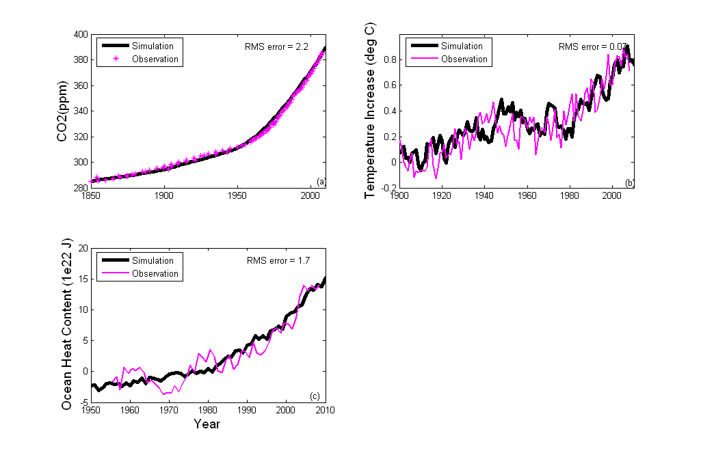
The Copenhagen Accord for Limiting Global Warming:
Criteria, Constraints and Available Avenues
Ramanathan and Xu, PNAS, 2010
An Integrated Carbon cycle-Climate
Model: Stochastic Model

Slide 24
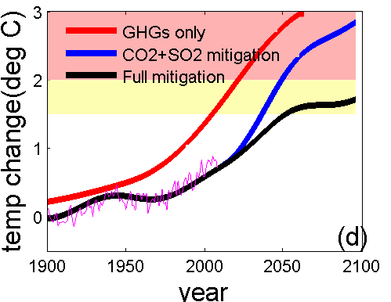
The Copenhagen Accord for Limiting Global Warming:
Criteria, Constraints and Available Avenues
Ramanathan and Xu, Submitted to PNAS, 2010

Slide 25
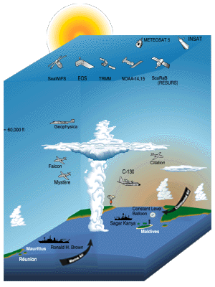
Indian Ocean Experiment (INDOEX):
1996-1999
Lead Agency: NSF; Lead Inst: SIO
Chief Scientists: Ramanathan & Crutzen
Chair Steering Committee: Ramanathan
International Collaboration is Vital
For Global Warming Research: INDOEX is an
Excellent example
European/ Indian/ Maldivian/American
Collaboration
Over 200 scientists from these nations
Joined INDOEX
The Aerosol and Brown Cloud problem
Was hit with every tool we had
Discovered that Aerosols in Atmospheric Brown Clouds Can cause dimming over vast areas of the Oceans and continents
Ramanathan et al (2001) & over 200 papers
in European, Indian and Americam Journals
Ramanathan 2007

Slide 26
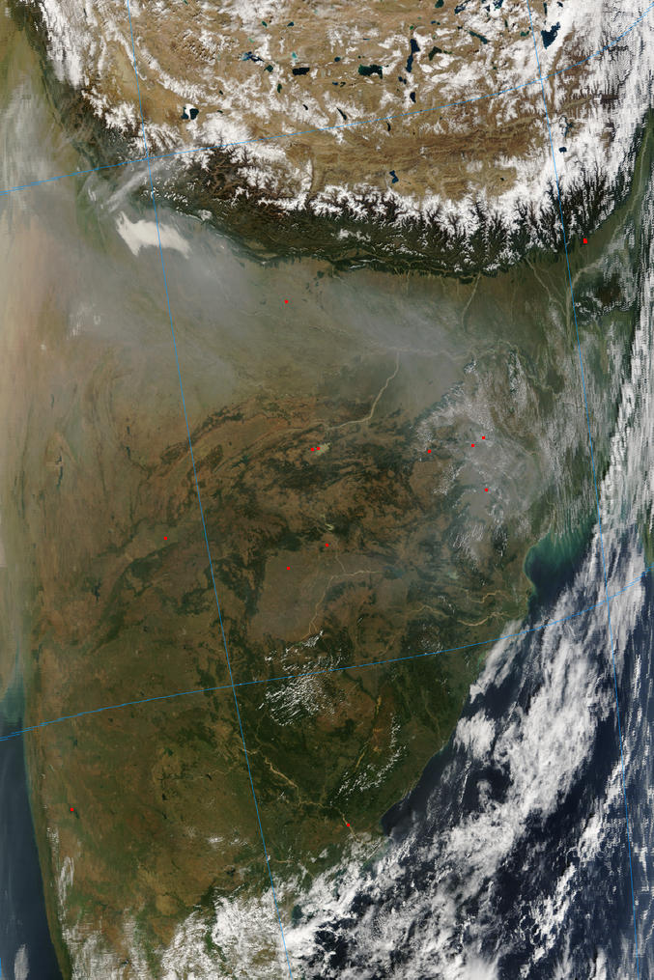
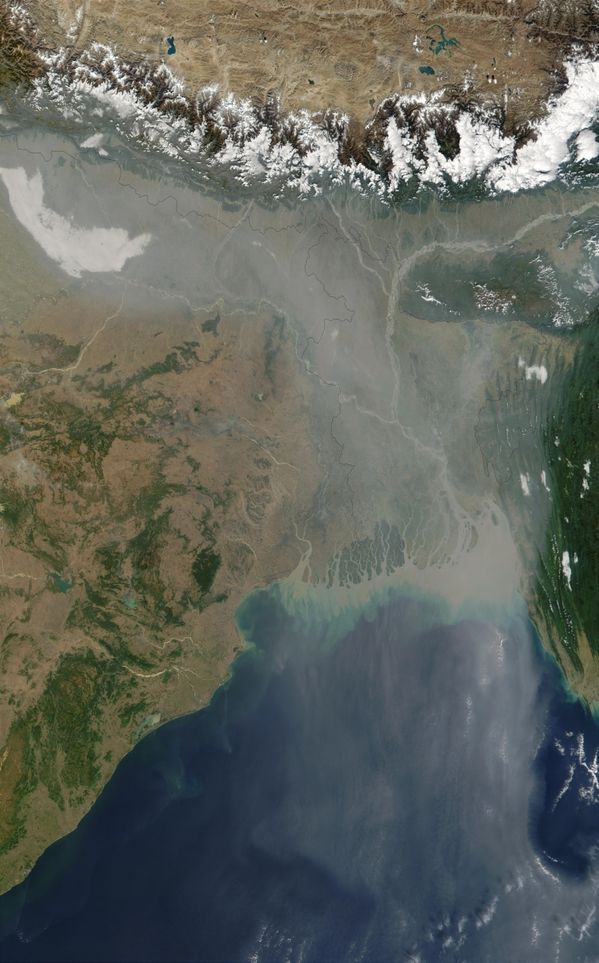
NASA-MODIS
November 14 2006
December 21 2001
Ramanathan 2007

Slide 27
Chemical Analysis of Filters over the Indian Ocean from C-130 aircraft
Ramanathan et al, 2001
Uncertainty < +- 4%
Plate 8

Slide 28
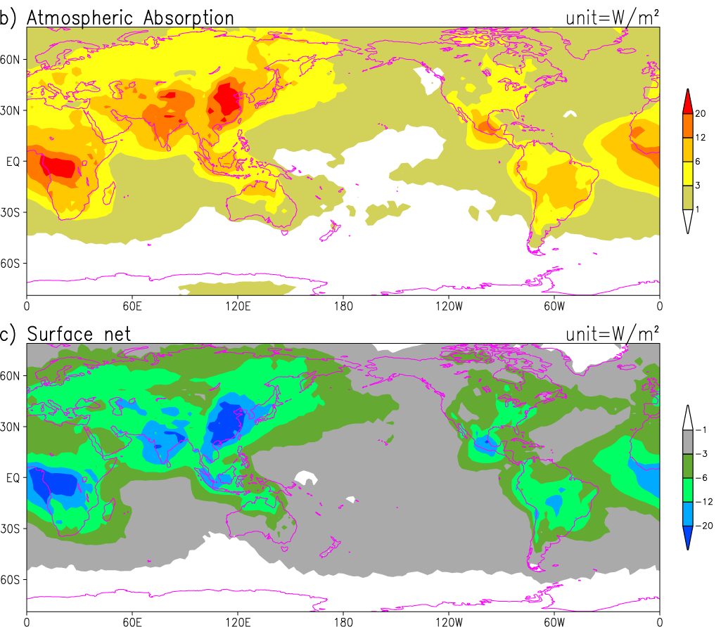
Masking of Global Warming: 2002
{A Synthesis of ground, aircraft and satellite observations}
Heating of Blanket by BC & Others
Forcing
GHGs = 3
ABCs = -1.4
(+-50%)
Dimming : Mirrors & BC
Chung, Ramanathan,
Kim, Podgorny,2005

Slide 29
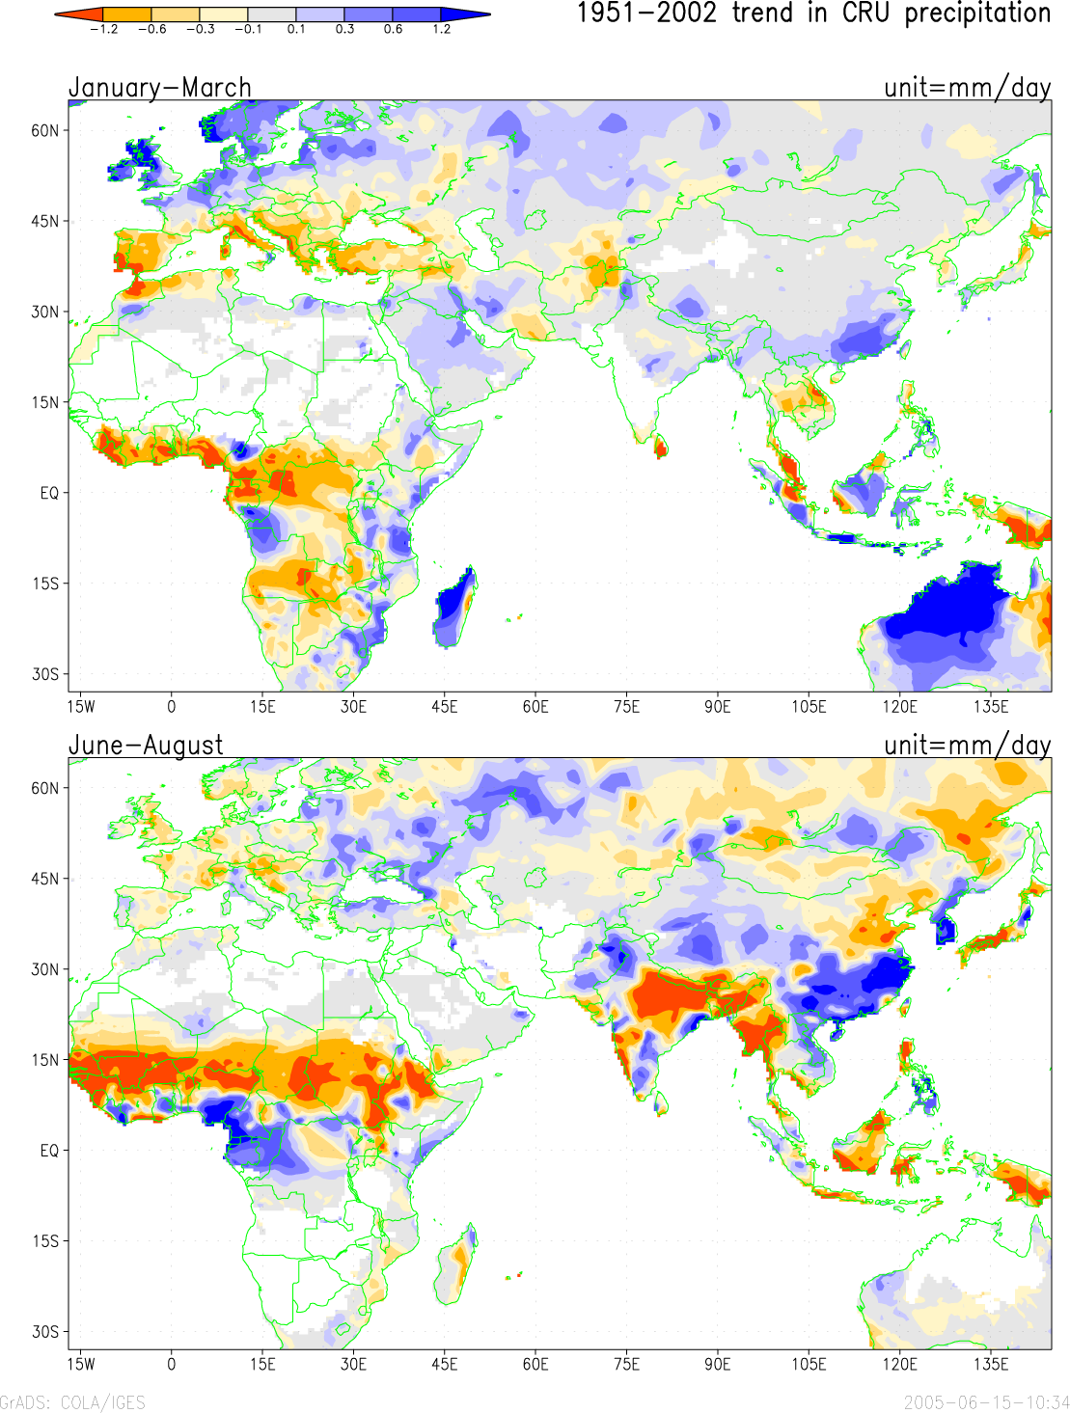
Major Rainfall Shifts during the last 50 Years
Chung and Ramanathan 2006
Observed Trends in Summer Rainfall: 1950 to 2002
N-S Shift in Asian rainfall
The Weakening Indian Monsoon
The Sahelian Drought

Slide 30

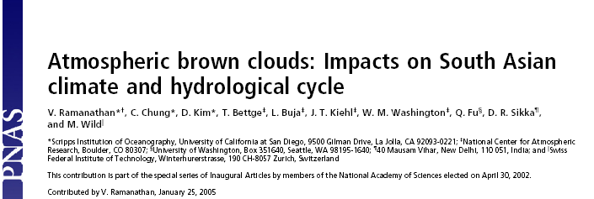
Proceedings of the National Academy of Sciences, April 2005
A Fully Coupled Ocean-Atmosphere Model Study from
1870 to 2025; Five Ensemble Runs:
The NCAR Parallel Climate Model;
GHG gas and volcanic forcing from 1870;
ABC forcing from INDOEX and past emissions histories

Slide 31
South Asian Dimming: Sunlight at the ground has decreased by 7%
Ramanathan et al, PNAS, 2005

Slide 32
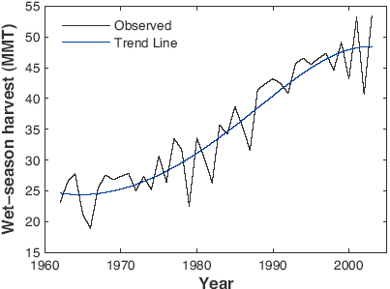
ABCs and GHGs Have Reduced Rice Harvest
Aufhammer, Ramanathan, Vincent, PNAS 2006
Green Revolution
Turned Brown?

Slide 33
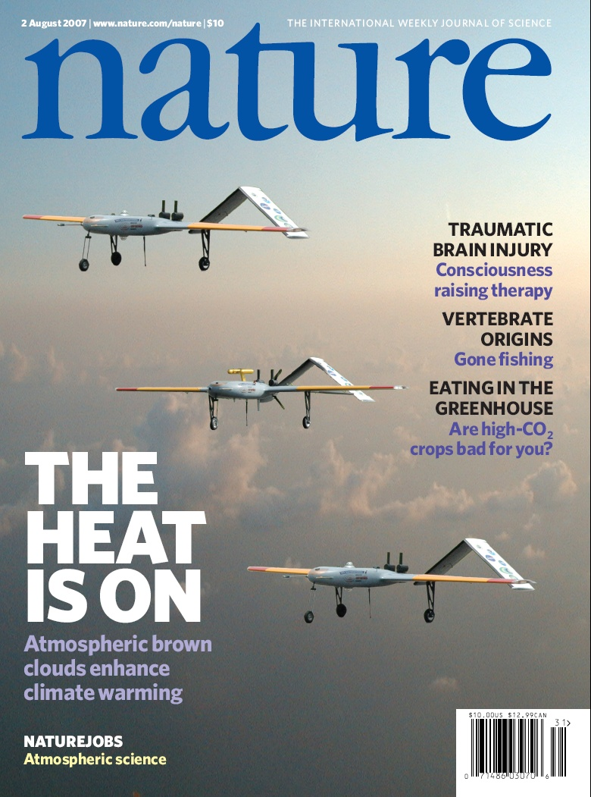
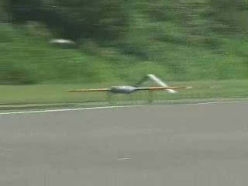
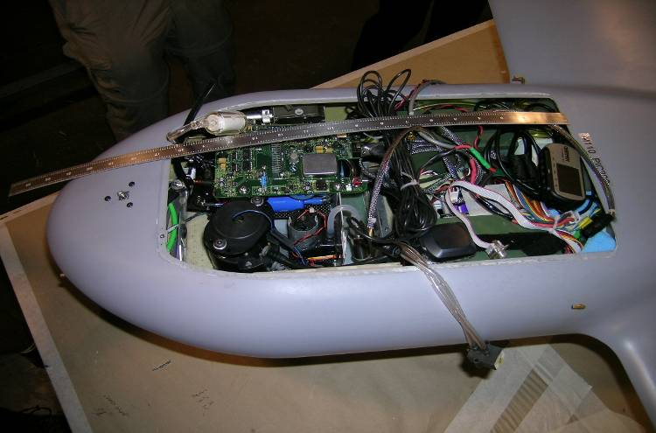
Nature 2007

Slide 34
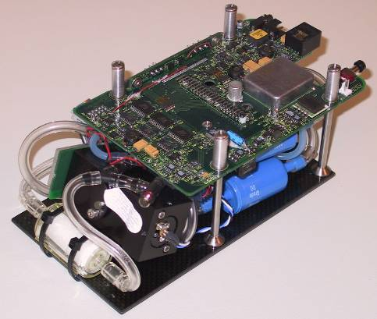
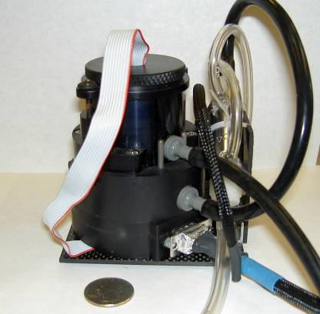
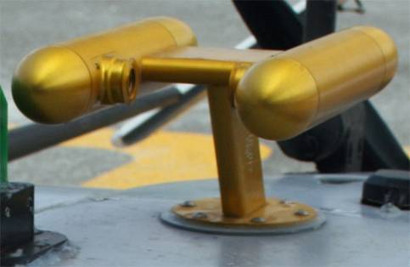
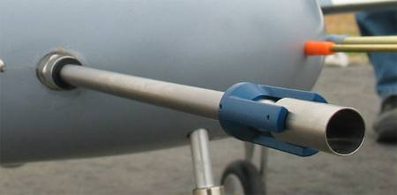
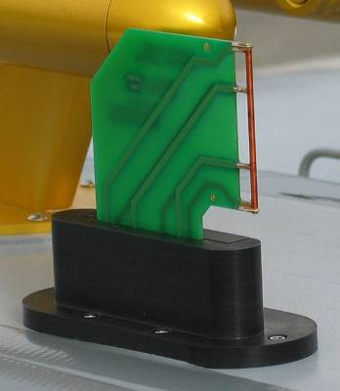
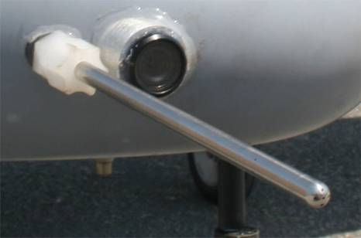
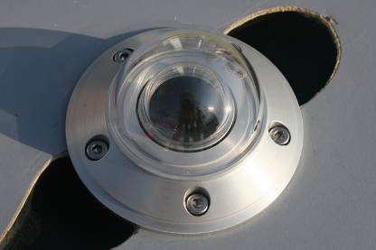
Miniaturized Instruments for UAV
Optical Particle Counter (580 g) → N_{OPC}; 0.3 < D_{p} < 3 μm
Condensation Particle Counter (870 g) → N_{CN}; D_{p} > 10 nm
[=] 1 inch
Aerosol inlet & splitter (150 g)
→ unbiased aerosol sampling
Cloud Droplet Spectrometer (1.4 kg) → distr. 1 < D < 50 μm
Aethalometer (820 g)
→ absorbing aerosol
T/RH probe (50 g)
→ Temperature & RH
Video camera (280 g)
→ cloud targeting
Pyranometer (190 g)
→ irradiance 0.3 – 2.8 μm
PAR radiometer (45 g)
→ irradiance 400 – 700 nm
LWC probe (450 g)
→ Cloud water (g m⁻³)

Slide 35
CALIPSO Aerosol Depth: Ramanathan et al, Nature, 2007

Slide 36

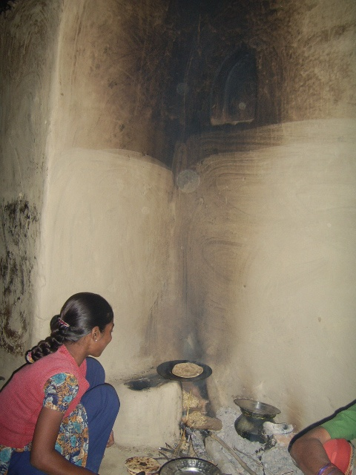
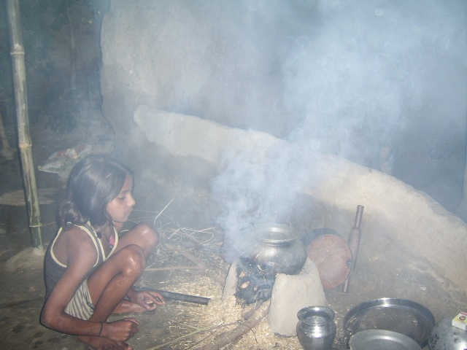
3 Billion can not afford fossil fuel
Project Surya on the Web: www.projectsurya.org

Slide 37
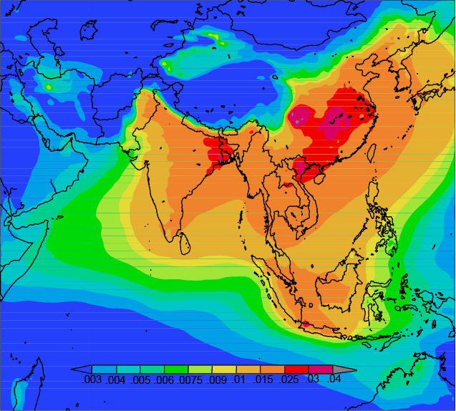
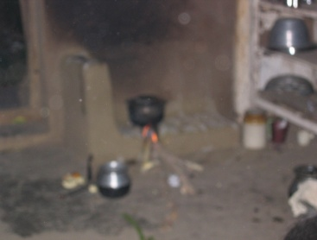
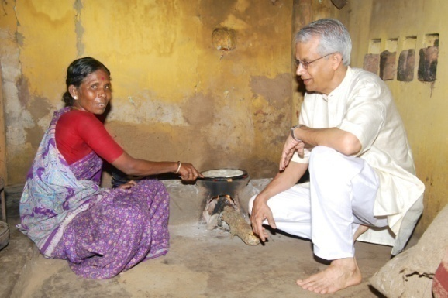
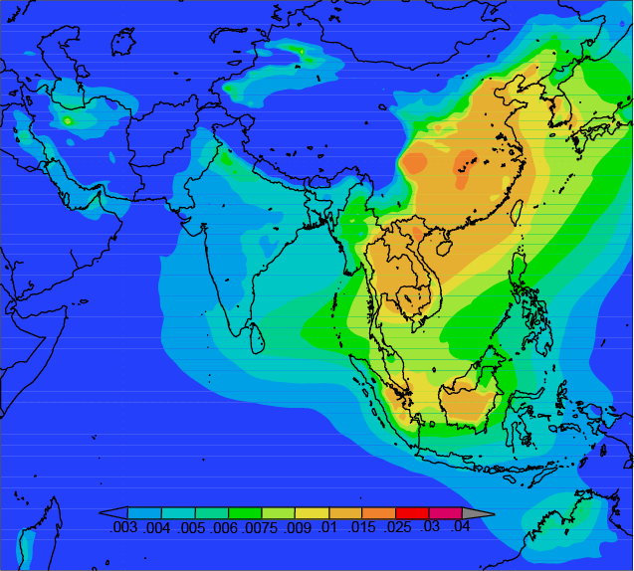
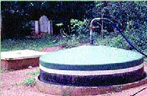


Target mitigation (Surya)
a) Baseline BC AOD for 2004/05
Rural Cooking
Fire wood
Ramanathan and Balakrishnan, 2007
Ramanathan and Carmichael, 2008
Biogas plants converts organic waste into gas
b) BC AOD without biofuels
Parabolic solar cooker

Slide 38


Slide 39



From personal observations to global patterns
(Nithya Ramanathan, CENS, UCLA)
+
Time spent in kitchen cooking
Activities outdoors (e.g. walk, run, drive)
Estimates pollution exposure
Map of exposure worldwide
NASA

Slide 40


Nithya Ramanathan, et al, 2010

Slide 41


Slide 42






Demonstration Phase: 2011 to 2013
Area: 100 Km²; Population: 50,000
…
N=2
N=10
N=1
N=3
…
…
Surya Auxiliary
Site (SAS)
N=41
N=50
E 81°34'
…
…
Cell
Phones
Improved Stove-2
(IS-2)
…….
N=91
N=100
N 26°30'
LPG
Biogas Plant
Surya Supersite
(S³)
Improved Stove-1
(IS-1)
Surya Control Site
S³[cs]
(SAS)
(SAS)
Solar Cooker
Hut
Observatory
Improved
Stove-2
(IS-2)
N 26°28'
Biogas Plant
Improved Stove-1
(IS-1)
Mobile
Laboratory
Solar Cooker
Untreated Control Region
(SAS)
Intervention Region

Slide 43

Bottom to Top of the Pyramid
The three to four billion people who live on less than $2 per day constitute the bottom of the economic and energy pyramid.
CAN WE STEER
THEM INTO A
SUSTAINABLE
NON-FOSSIL
FUEL PATHWAY
and enable
Them To climb
the energy
pyramid?

Slide 44


1975
Zaelke
Economist, Dec 12 2009

